Slide 1
Problem Statement The clinic has gotten several complaints regarding wait times. Task: Analysis, hypothesis, data story on overall wait time. Question from Management Why are we getting these complaints?  Do the hospital have staffing issues?  Are the complaints legitimate?  Is the hospital too busy?  Is it due to a certain type of patient?
HOSPITAL ANALYSIS

Slide 2
Tools for Analysis
EXCEL
Pivot Tables
IF conditional
Conditional Formatting
Time conversions
New Dimensions
Functions: TEXT, DAYOFWEEK
Data Story (Beginning, Middle and End)
Power Point

Slide 3
Who is waiting the Longest?
Financial Class
From the analysis, Financial Class does not significantly change the wait times. Although it seems Medicare takes the longest time to process. We do not have enough patients to conclude that this is a major factor.

Slide 4
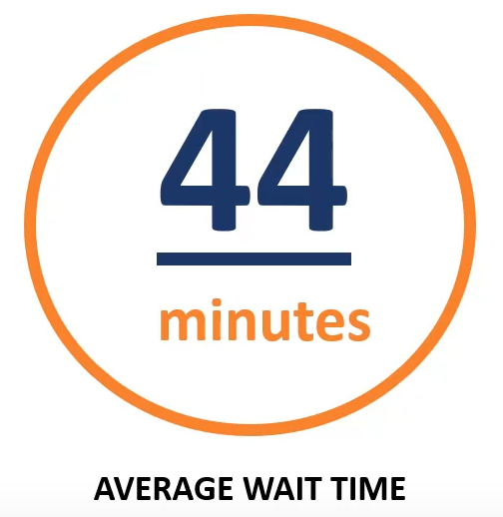
What Days of Week are Affected?

Slide 5
Are Wait Times Associated with Busy Periods?
Lack of Staffing
From the existing data, it seems that staffing is sufficient. However, we may want to look at ensuring we have adequate staffing at the appropriate hours.

Slide 6
Where do We Need Staff?
Staff Breakdown:
We should focus our efforts on the medical staff because we are assuming the time to wait to see the doctor is limited by the number of doctors.

Slide 7
Summary
Based on the analysis, there may be a possibility to add more medical staff during the morning rush period.
Other Actions
Determine if it makes financial sense to have additional medical staffing during morning hours.
Determine if the pre and post consultation times are trending positively or negatively.

